Slide 1
User Datagram Protocol (UDP)

Slide 2
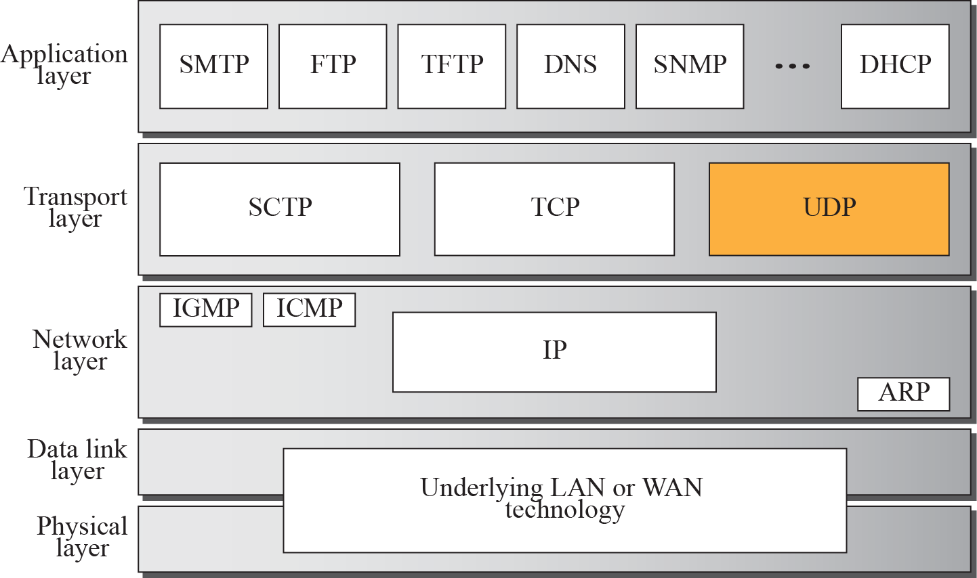
Position of UDP in the TCP/IP protocol suite

Slide 3
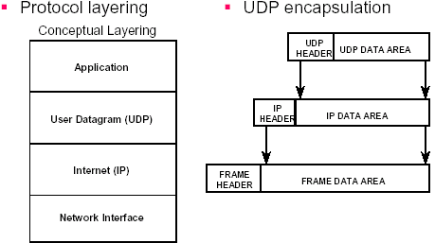


Encapsulation and Layering
UDP message is encapsulated into an IP datagram.
IP datagram in turn is encapsulated into a physical frame for actually delivery.

Slide 4

UDP is another transport protocol in the TCP/IP suite - “best effort” transport protocol
Standard connectionless protocol for the transport layer of the Internet architecture
connectionless:
no handshaking between UDP sender, receiver before packets start being exchanged
each UDP segment handled independently of others
allows an application to send datagram to other application on the remote machine.

Slide 5
Just provides multiplexing/demultiplexing i.e. Only adds demultiplexing capability to basic best-effort delivery provided by IP
Needs to identify target process for message
Could use some direct identifier like process ID, but that might not work with all Operating Systems
Instead uses indirect handle, the port number
delivery and duplicate detection are not guaranteed.
Low overhead: faster than TCP

Slide 6
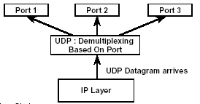
UDP Multiplexing & Demultiplexing
Sender: multiplexing of UDP datagrams.
UDP datagrams are received from multiple application programs.
A single sequence of UDP datagrams is passed to IP layer.
Receiver: demultiplexing of UDP datagrams.
Single sequence of UDP datagrams received from IP layer.
UDP datagram received is passed to appropriate application.

Slide 7
UDP provides an unreliable datagram service
– Packets may be lost or delivered out of order
– Users exchange datagrams (not streams)
– Connection-less
– Not buffered -- UDP accepts data and transmits immediately (no buffering before transmission)
– Full duplex -- concurrent transfers can take place in both directions

Slide 8






UDP Characteristics
End-to-End: an application sends/receives data to/from another application.
Connectionless: Application does not need to preestablish communication before sending data; application does not need to terminate communication when finished.
Message-oriented: application sends/receives individual messages (UDP datagram), not packets.
Best-effort: same best-effort delivery semantics as IP. I.e. message can be lost, duplicated, and corrupted.
Arbitrary interaction: application communicates with many or one other applications.
Operating system independent: identifying application does not depend on O/S.

Slide 9
Applications
Often used for streaming multimedia apps
loss tolerant
rate sensitive
Used by
DNS
SNMP
reliable transfer over UDP: add reliability at application layer
application-specific error recovery!

Slide 10
Pros:
No connection establishment
No delay to start sending/receiving packets
Simple
no connection state at sender, receiver
Small segment header
Just 8 bytes of header

Slide 11
Cons:
“best effort” transport service means, UDP segments may be:
lost
delivered out of order to app
no congestion control: UDP can blast away as fast as desired

Slide 12
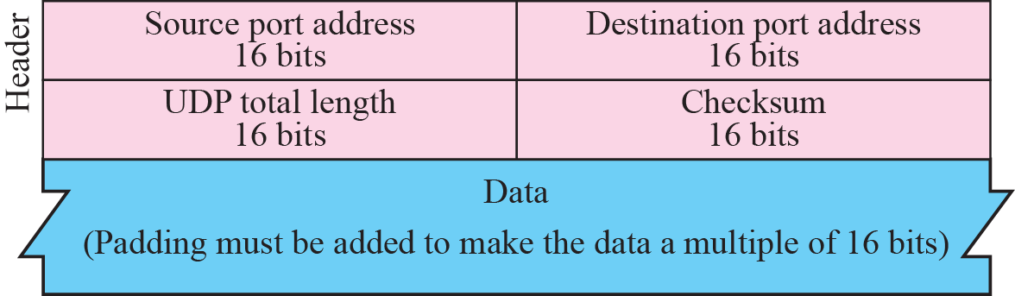
UDP Datagram Format
Source Port - 16 bit port number
Destination Port - 16 bit port number
Length (of UDP header + data) - 16 bit count of octets
UDP checksum - 16 bit field. if 0, then there is no checksum, else it is a checksum over a pseudo header +UDP header + UDP data area

Slide 13
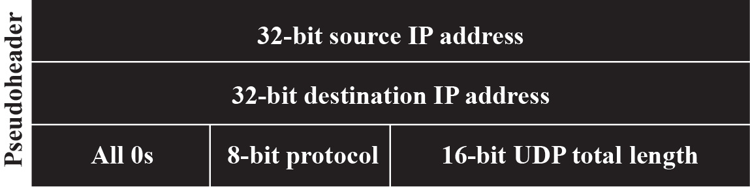
Pseudo Header
UDP uses a pseudo-header to verify that the UDP message has arrived at both the correct machine and the correct port.

Slide 14
UDP Datagrams
Used for Mux/Demux
UDP packets, called user datagrams, have a fixed-size header of 8 bytes.
UDP header contains source port, destination port, length, and checksum (all two bytes)
Source and destination ports are only unique on the respective hosts –key is pair of (host, port) values
32 bits
Length, in
bytes of UDP
segment,
including
header
source port #
dest port #
length
checksum
Application
data
(message)
UDP segment format

Slide 15
UDP does ensure correctness of packet using checksum.
–Optional in current UDP, required in IPv6
–Checksum computed over message data, UDP header, and pseudoheader –protocol number and source and destination IP addresses, plus UDP length
–Uses same checksum as IP

Slide 16
UDP checksum
Goal: detect “errors” (e.g., flipped bits) in transmitted segment
Receiver:
compute checksum of received segment
check if computed checksum equals checksum field value:
NO - error detected
YES - no error detected. But maybe errors nonetheless?
Reordered bytes
Why checksum at UDP if LL provides error checking?
IP is supposed to run over ANY LL, so UDP does its own error checking
Sender:
treat segment contents as sequence of 16-bit integers
checksum: addition (1’s complement sum) of segment contents
sender puts checksum value into UDP checksum field

Slide 17
Identifying An Application
UDP cannot extend IP address
No unused bits
Cannot use OS-dependent quantity
Process ID, Task number, Job name
Must work on all computer systems
Technique
Each application assigned unique integer
Called protocol port number

Slide 18
Protocol Port Number
UDP uses Port Number to identify an application as an endpoint.
UDP messages are delivered to the port specified in the message by the sending application
In general, a port can be used for any datagram, as long as the sender and the receiver agrees
In practice, a collection of well-known ports are used for special purposes such as telnet, ftp, and email. E.g. port 7 for Echo application.
Local operating system provides an interface for processes to specify and access a port.

Slide 19
Obtaining Port Number
•Need host IP and port to talk to server
–Once server has address, it can respond to address in packet it received
•Different techniques for getting port #
–Use a well-known port (i.e. DNS uses 53)
•Values found in /etc/services
–Use a port mapper–single process that runs on the server and knows the ports for different services
–Use a directory service that runs on the network and knows the port numbers for services on any host

Slide 20
Implementation
Typically, a port is implemented by OS as a message queue
–Incoming messages added to queue for specified port
–Messages removed by application when it reads the port
–Messages discarded if queue is full
–Process blocks if queue is empty when it reads

Slide 21
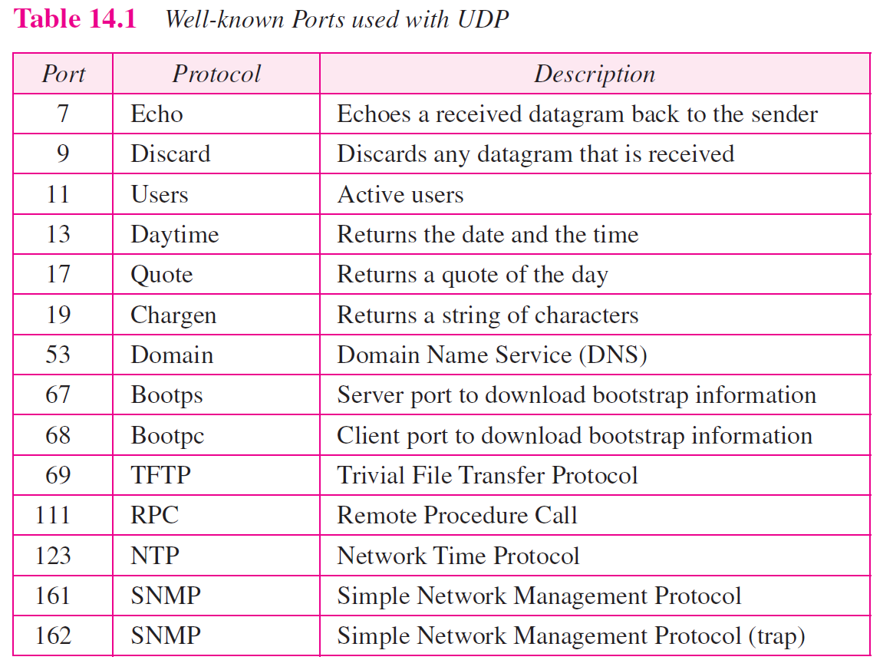

Slide 22
How to program using the UDP?
TCP UDP
IP
LL
PL
Socket Layer
TCP UDP
IP
LL
PL
Socket Layer
TCP UDP
IP
LL
PL
Socket Layer
Socket Layer:
Programmer’s API to the protocol stack
Typical network app has two pieces: client and server
Server: Passive entity. Provides service to clients
e.g., Web server responds with the requested Web page
Client: initiates contact with server (“speaks first”)
typically requests service from server, e.g., Web Browser

Slide 23
Socket Creation
mySock = socket(family, type, protocol);
UDP/TCP/IP-specific sockets
Socket reference
File (socket) descriptor in UNIX
Socket handle in WinSock
 | Family | Type | Protocol
TCP | PF_INET | SOCK_STREAM | IPPROTO_TCP
UDP |  | SOCK_DGRAM | IPPROTO_UDP
Notes:
Socket descriptors can be used just like file descriptors in UNIX. In WinSock, Socket handles and file handles are not the same thing.

Slide 24

UDP Client/Server Interaction
Server starts by getting ready to receive client messages…
Client
Create a UDP socket
Communicate (send/receive messages)
When done, close the socket
Server
Create a UDP socket
Assign a port to socket
Communicate (receive/send messages)
When done, close the socket
Notes:
Students should follow along with source code in the book

Slide 25
UDP Versus TCP
Choice of UDP versus TCP is based on:
Functionality
Performance
Performance
– TCP’s window-based flow control scheme leads to bursty bulk transfers (not rate based)
– TCP’s “slow start” algorithm can reduce throughput
– TCP has extra overhead per segment
– UDP can send small, inefficient datagrams

Slide 26
Reliability
– TCP provides reliable, in-order transfers
– UDP provides unreliable service – application must accept or deal with
• Packet loss due to overflows and errors
• Out-of-order datagrams
Multicast and broadcast
– Supported only by UDP
– TCP’s error control scheme does not lend itself to reliable multicast
Data size
– UDP datagrams limited to IP MTU (64KB)

Slide 27
Application complexity
– Application-level framing can be difficult using TCP because of the Nagle algorithm
– Nagle algorithm controls when TCP segments are sent to use IP datagrams efficiently
– But, data may be received and read by applications in different units than how it was sent

